Slide 1

Sequence Diagram
pandhi Renuka id: 6167
Nitin kumar gaur id:6168
Date : 24/09/2021

Slide 2

UML(unified Modeling Language)
UML (Unified Modeling Language) is a standard language for specifying, visualizing, constructing, and documenting the artifacts of software systems.
Its Technical method to explain the future product by just drawing some diagram and define the flow of execution of software system.
UML is a modeling toolkit that guides the creation and notation of many types of diagrams, including behavior diagrams, interaction diagrams, and structure diagrams.

Slide 3

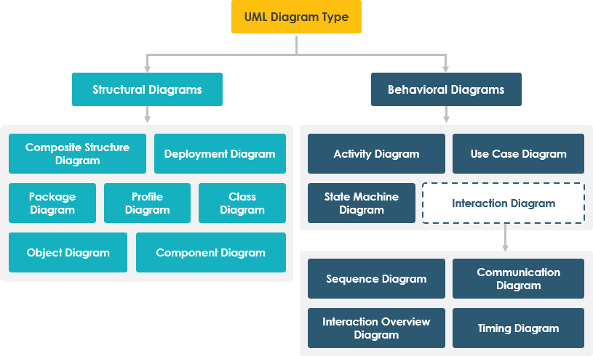
What’s next
LOOKING AHEAD

Slide 4
1.Sequence diagrams describe interactions among classes in terms of an exchange of messages over time. They're also called event diagrams 2. A sequence diagram is a type of interaction diagram because it describes how—and in what order—a group of objects works together. These diagrams are used by software developers and business professionals to understand requirements for a new system or to document an existing process
Sequence diagram

Slide 5
Basic symbols and components of sequence diagram
Symbol Name Description
The object symbol demonstrates how an object will behave in the context of the system
Object symbol
Represents the time needed for an object to complete a task. The longer the task will take, the longer the activation box becomes.
Activation box
Actor symbol
Shows entities that interact with or are external to the system.

Slide 6
Basic symbols and components of sequence diagram
Symbol Name Description
USER
Represents the passage of time as it extends downward.
Lifeline symbol
|
|
(condition)
Option loop symbol
Used to model if/then scenarios
Symbolizes a choice (that is usually mutually exclusive) between two or more message sequences
----------------
Alternative symbol
else

Slide 7
Common message symbols
Symbol | Name | Description
This symbol is used when a sender must wait for a response to a message before it continues
Synchronous message symbol
Asynchronous messages don't require a response before the sender continues. Only the call should be included in the diagram.
Asynchronous message symbol
Represented by a dashed line with a lined arrowhead
<---------------------
Asynchronous create message symbol
- - -- - - - - -- - >
Represented by a dashed line with a lined arrowhead. This message creates a new object.
Asynchronous create message symbol

Slide 8
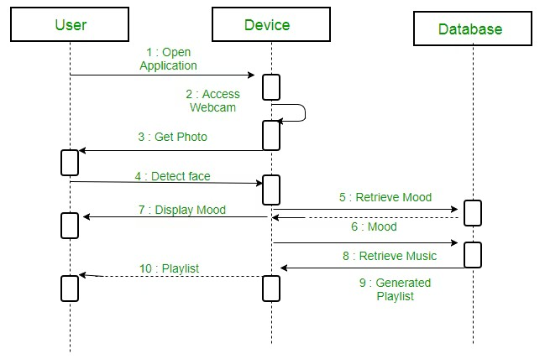
Example of Sequence Diagram

Slide 9
THANK YOU

